Slide 1
Container instance
Hosting a simple docker on it

Slide 2
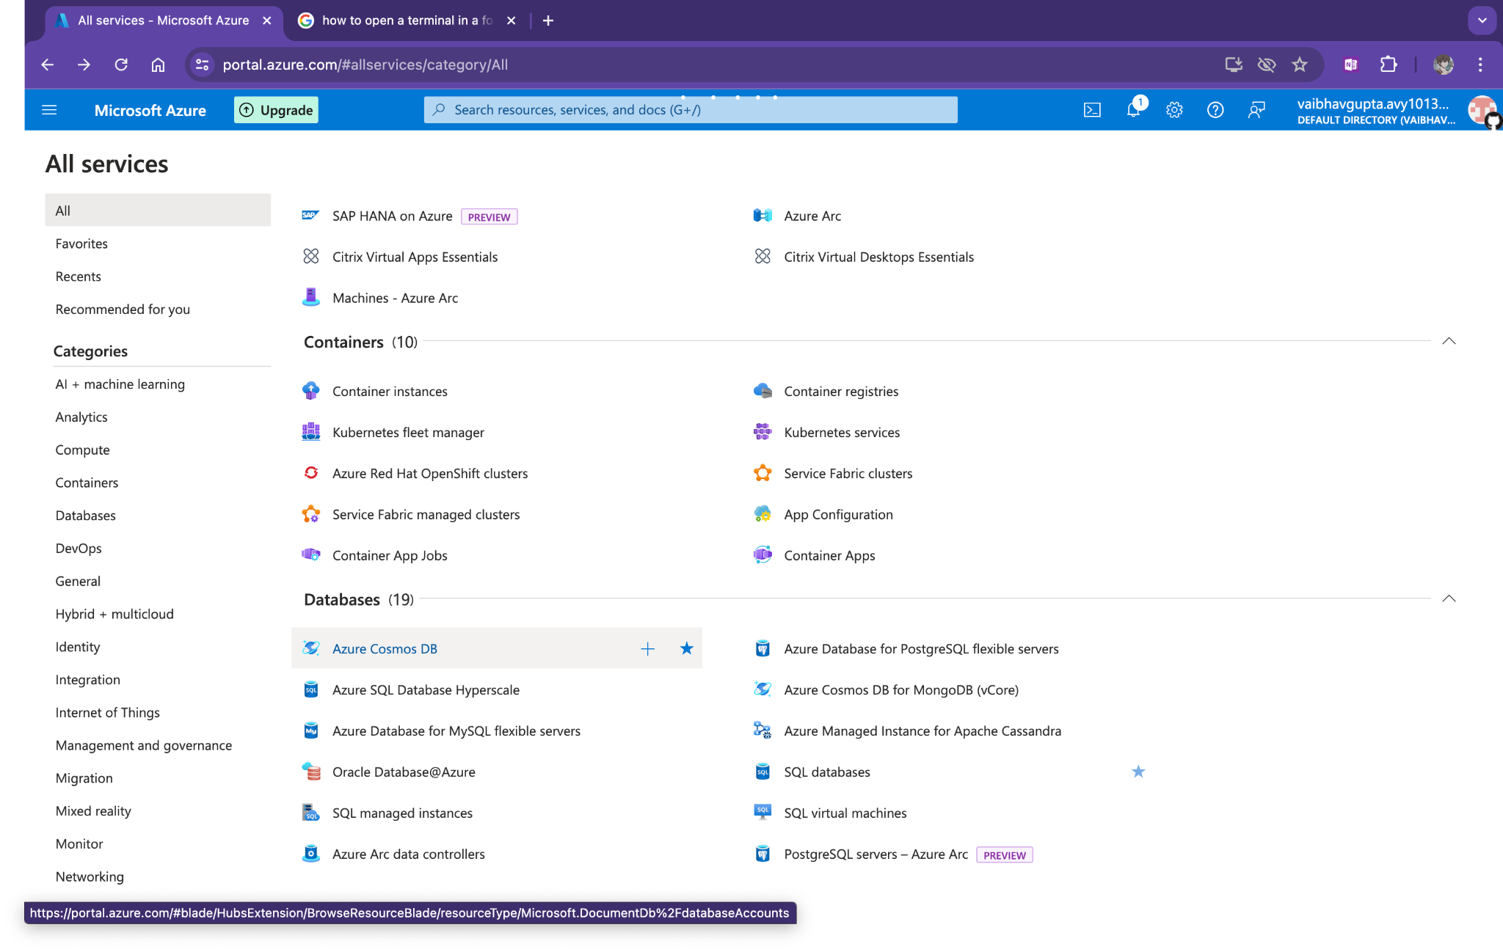
Search for container instance

Slide 3
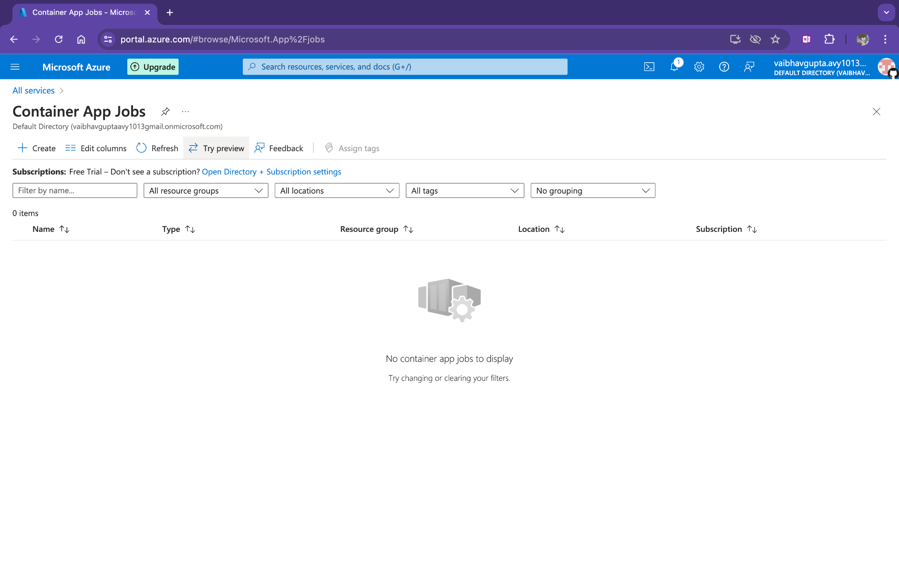
Create a instance

Slide 4
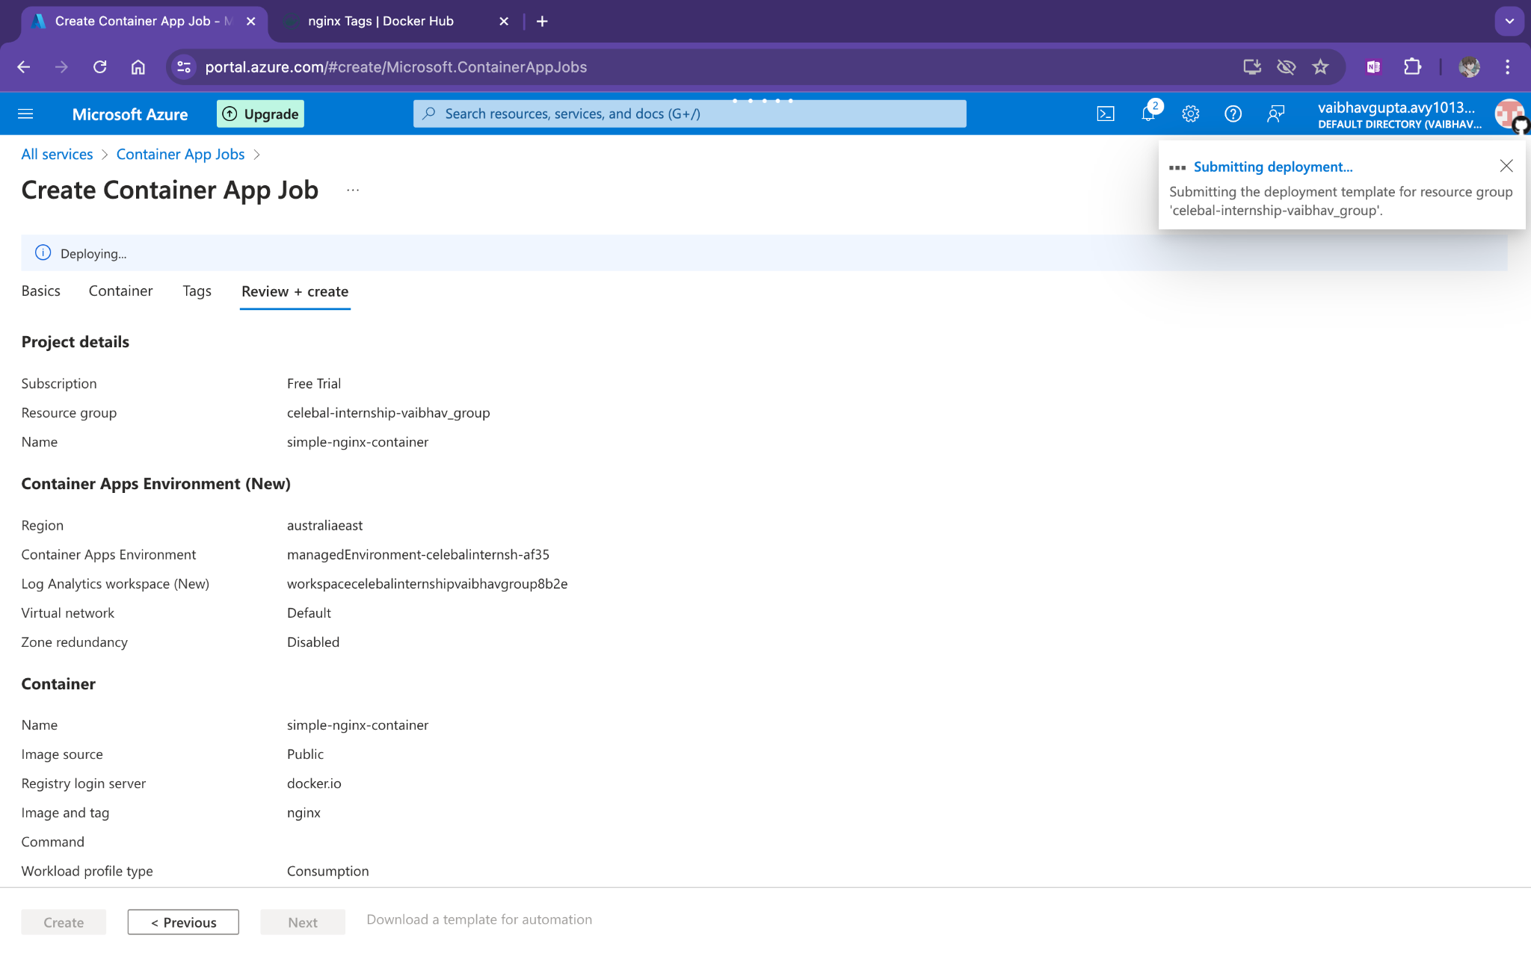
Finalizing deployment

Slide 5
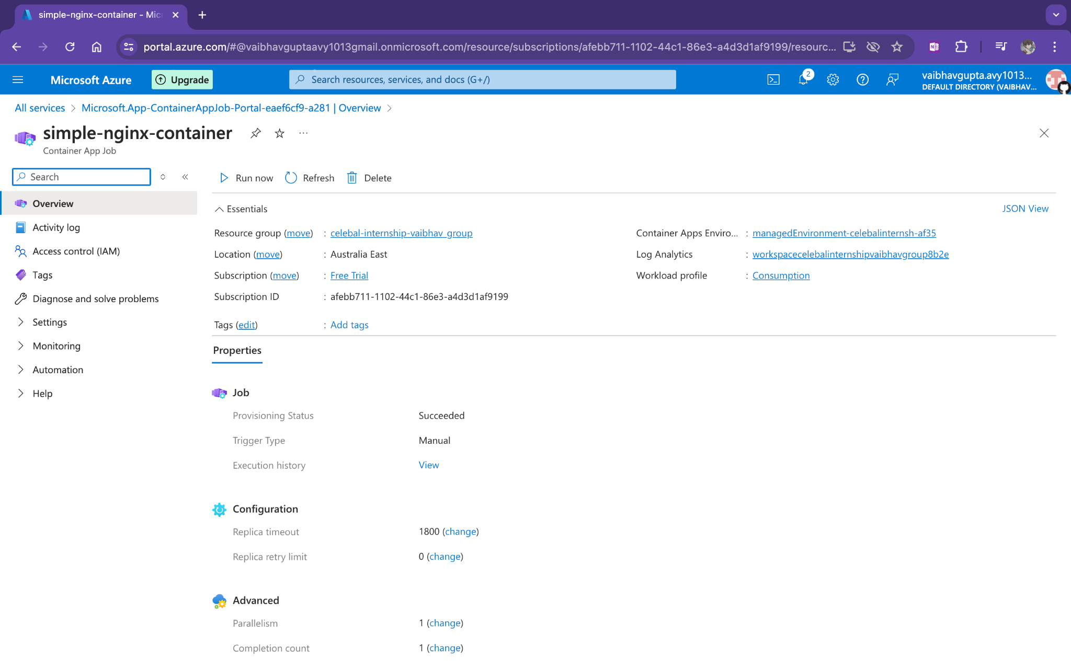
Docker Deployed

Slide 6
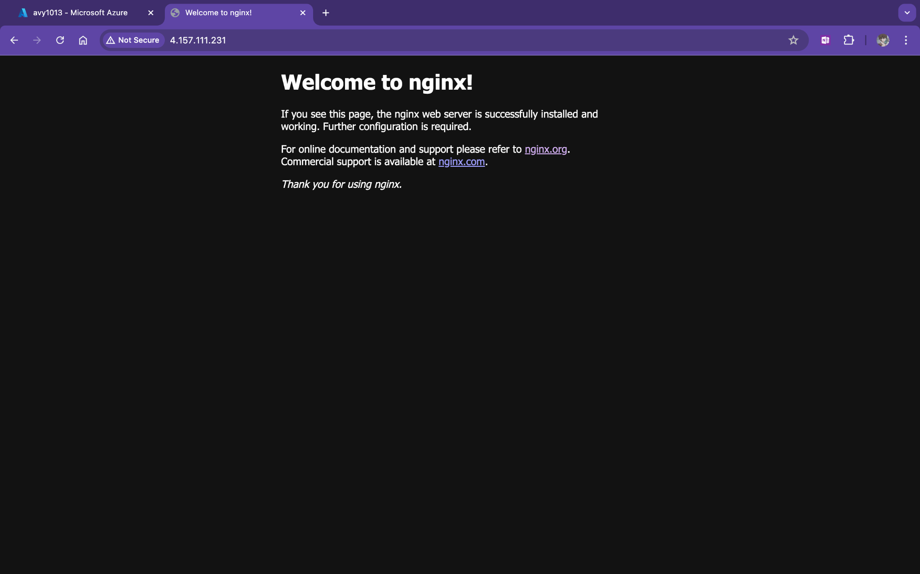
Container running

